Slide 1


Renton Fish and Game Club
USPSA
Oktober 2022
Trigger Treat
Match Booklet
Round Count: 272

Slide 2
Stage 1 Check Your Corners Course Designer: Marcel Englmaier
Check Your Corners is a 45 round, 225 point Comstock course. There are 10 USPSA targets, 10 IPSC targets, 4 steel targets, and a single Clay. The best two hits per target will score. Steel must fall to score. Clay must be shot to score but is an bonus target. The start signal is audible.
The start position is standing with toes touching marks and wrists below belt. Both firearms are UNLOADED and staged in dump box.
On the audible start signal, engage targets from within the shooting area. USPSA targets may be engaged with PCC ONLY. IPSC targets may be engaged with Handgun ONLY. Steel may be engaged with either Handgun or PCC, NO RIFLE. Rifle is permitted to swap for PCC in this bay.

Slide 3
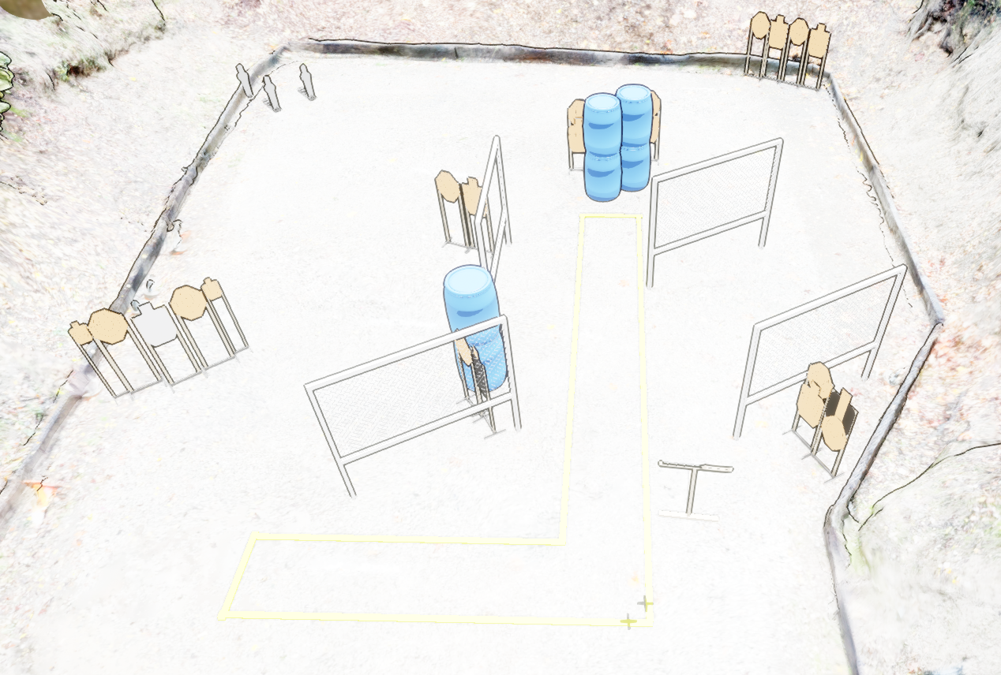
 | Stage 1 Check Your Corners Course Designer: Marcel Englmaier

Slide 4
Stage 2 Zero Check Course Designer: Jordan Rogers
Zero Check is a 28 round, 140 point VIRGINIA count standards exercise. There are 9 paper targets. The best two hits per hardcover target and best four hits per open target will score. The start signal is audible.
String 1 & 2 start position: Standing in box A, PCC loaded, safety on, muzzle touching the barricade.
String 1: On the audible start signal, from box A, engage each hardcover target with one round each, perform a mandatory reload and engage each hardcover target with one round each. String 2: On the audible start signal, engage each open target with two rounds each from box A, perform a mandatory reload, then engage each open target with two rounds each from box B, WEAK SIDE ONLY. You may use the barricade for support when shooting from box A. This is a PCC-only stage. Rifle is permitted to swap for PCC in this bay.

Slide 5
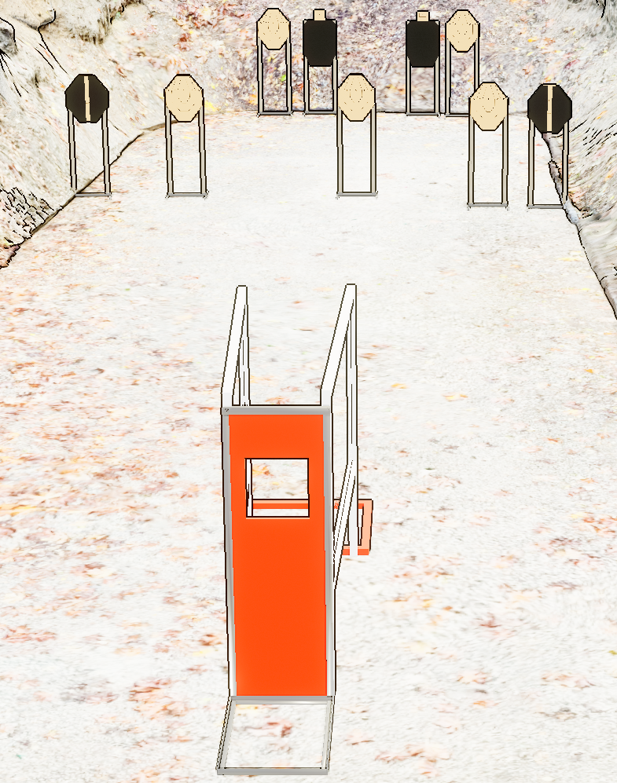
 | Stage 2 Zero Check Course Designer: Jordan Rogers
B
A

Slide 6
Stage 3 Accuracy is Accidental Course Designer: Eric Beerbaum & Marcel Englmaier
Accuracy is Incidental is a 58 round, 290 point Comstock course. There are 17 USPSA targets and 12 IPSC targets. The best two hits per paper target will score. The start signal is audible.
The Handgun start position is standing outside the shooting area with heels touching box A. Handgun loaded and holstered OR PCC loaded with safety on, stock on belt, and muzzle pointing down range. Your second firearm is UNLOADED and staged in dump box.
On the audible start signal, engage targets from within the shooting areas. USPSA targets may be engaged with PCC ONLY. IPSC targets may be engaged with Handgun ONLY. Rifle is permitted to swap for PCC in this bay.

Slide 7
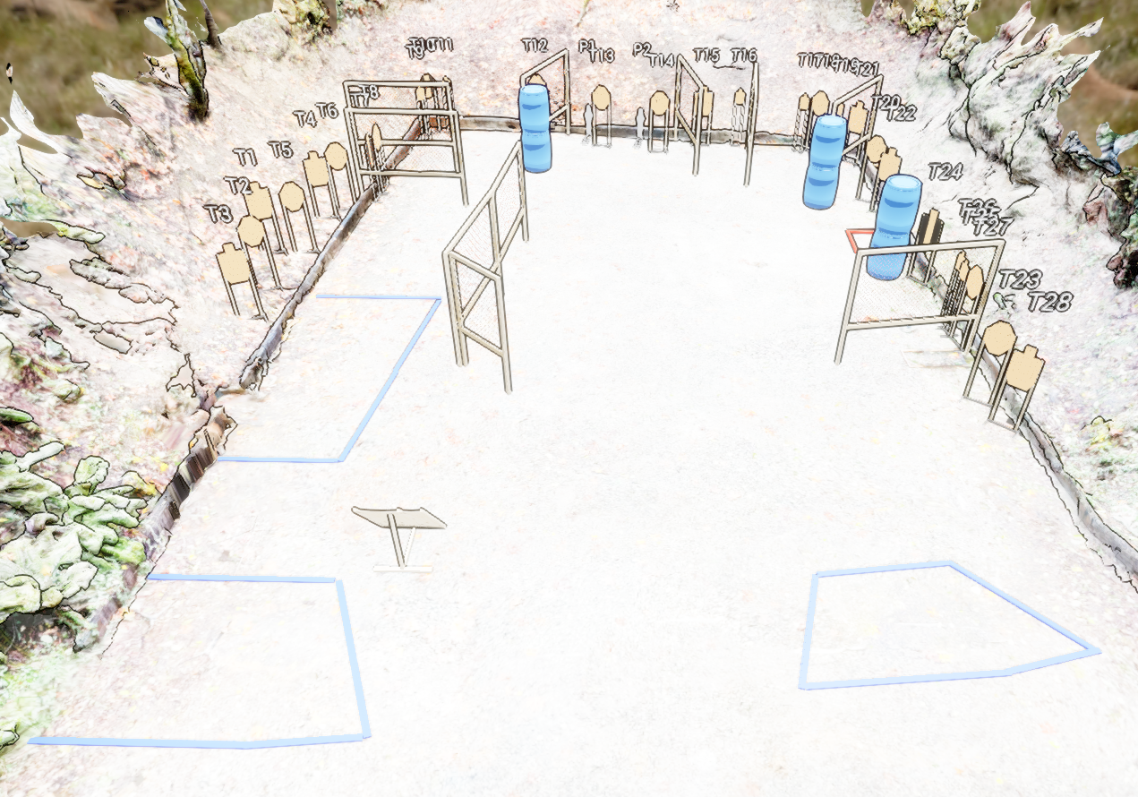
 | Stage 3 Accuracy is Accidental Course Designer: Eric Beerbaum & Marcel Englmaier

Slide 8
Stage 4 Three Many Choices Course Designer: Jordan Rogers
Three Many Choices is a 37 round, 185 point Comstock long course. There are 9 USPSA targets, 7 IPSC targets, 4 steel targets, and a single Clay. The best two hits per target will score. Steel must fall to score. Clay must be shot to score but is a bonus target. The start signal is audible.
The start position is standing anywhere within any shooting area. Handgun loaded and holstered OR PCC loaded with safety on, stock on belt, and muzzle pointing down range. Your second firearm is UNLOADED and staged in dump box.
On the audible start signal, engage targets from within the shooting areas. USPSA targets may be engaged with PCC ONLY. IPSC targets may be engaged with Handgun ONLY. Steel may be engaged with either Handgun or PCC.

Slide 9
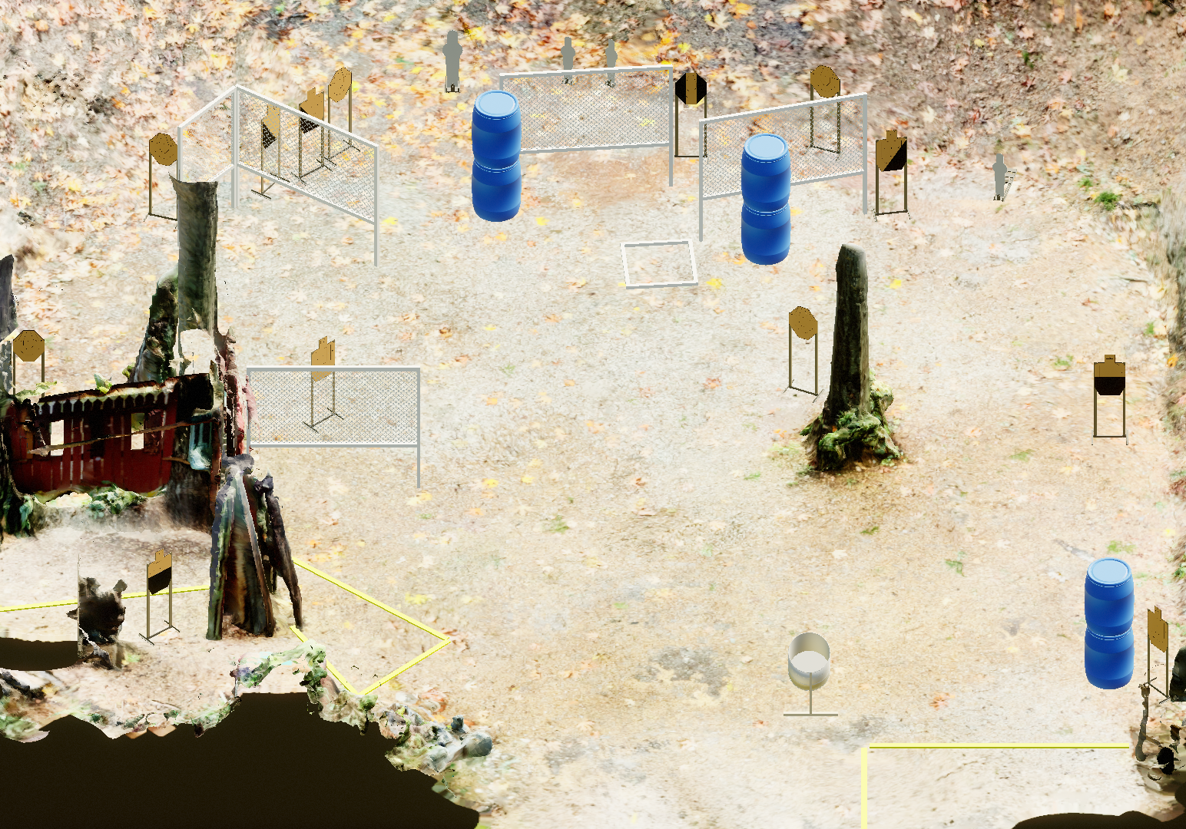
 | Stage 4 Three Many Choices Course Designer: Jordan Rogers

Slide 10
Stage 5 Index Check Course Designer: Marcel Englmaier
Index Check is a 32 round, 160 point VIRGINIA count standards exercise. There are 31 paper targets and a single Clay. The best one hit per target will score. Clay must be shot to score. The start signal is audible.
The Handgun start position is standing outside the shooting area with heels touching marks. Handgun is loaded and holstered with wrists below belt.
On the audible start signal, engage targets from within the shooting area with ONE round each. This is a handgun-only stage.

Slide 11
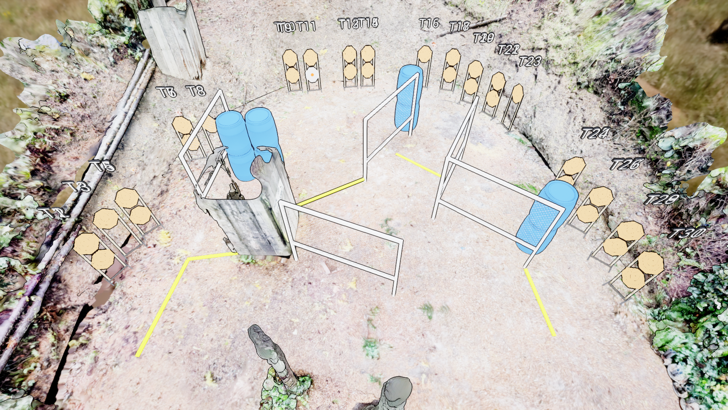
 | Stage 5 Index Check Course Designer: Marcel Englmaier
XX

Slide 12
Stage 6 Me Frosted Flakes Course Designer: Eric Beerbaum & Marcel Englmaier
Me Frosted Flakes is a 31 round, 155 point Comstock medium course. There are 7 USPSA targets, and 7 IPSC targets, and 3 steel targets. The best two hits per target will score. Steel must fall to score. The start signal is audible
The start position is standing with toes touching marks. Handgun loaded and holstered OR PCC loaded with safety on, stock on belt, and muzzle pointing down range. Your second firearm is UNLOADED and staged in dump box.
On the audible start signal, engage targets from within the shooting areas. USPSA targets may be engaged with PCC ONLY. IPSC targets may be engaged with Handgun ONLY. Steel may be engaged with either Handgun or PCC.

Slide 13
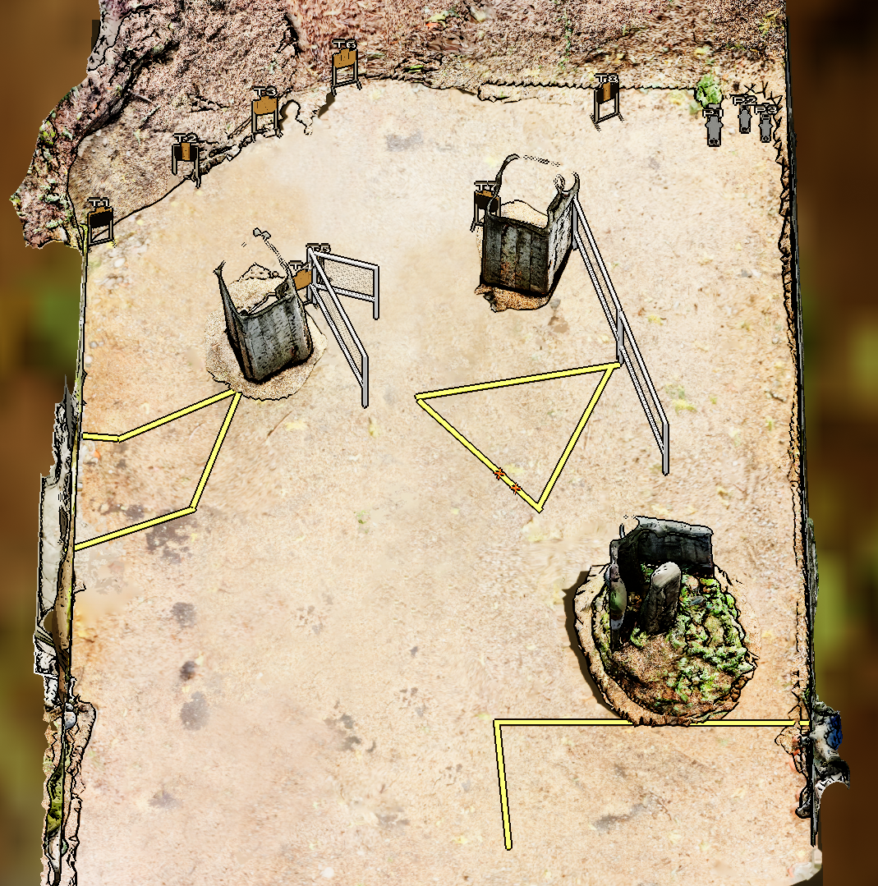
 | Stage 6 Me Frosted Flakes Course Designer: Eric Beerbaum & Marcel Englmaier

Slide 14
Stage 7 nOt A TRACK mEeT Course Designer: Jordan Rogers
nOt A TRACK mEeT is a 41 round, 205 point Comstock long course. There are 7 USPSA targets, 10 IPSC targets, and 7 steel targets. The best two hits per target will score. Steel must fall to score. The start signal is audible.
The start position is standing with toes touching marks. Handgun loaded and holstered OR PCC loaded with safety on, stock on belt, and muzzle pointing down range. Your second firearm is UNLOADED and staged in dump box.
On the audible start signal, engage targets from within the shooting areas. USPSA targets may be engaged with PCC ONLY. IPSC targets may be engaged with Handgun ONLY. Steel may be engaged with either Handgun or PCC.

Slide 15
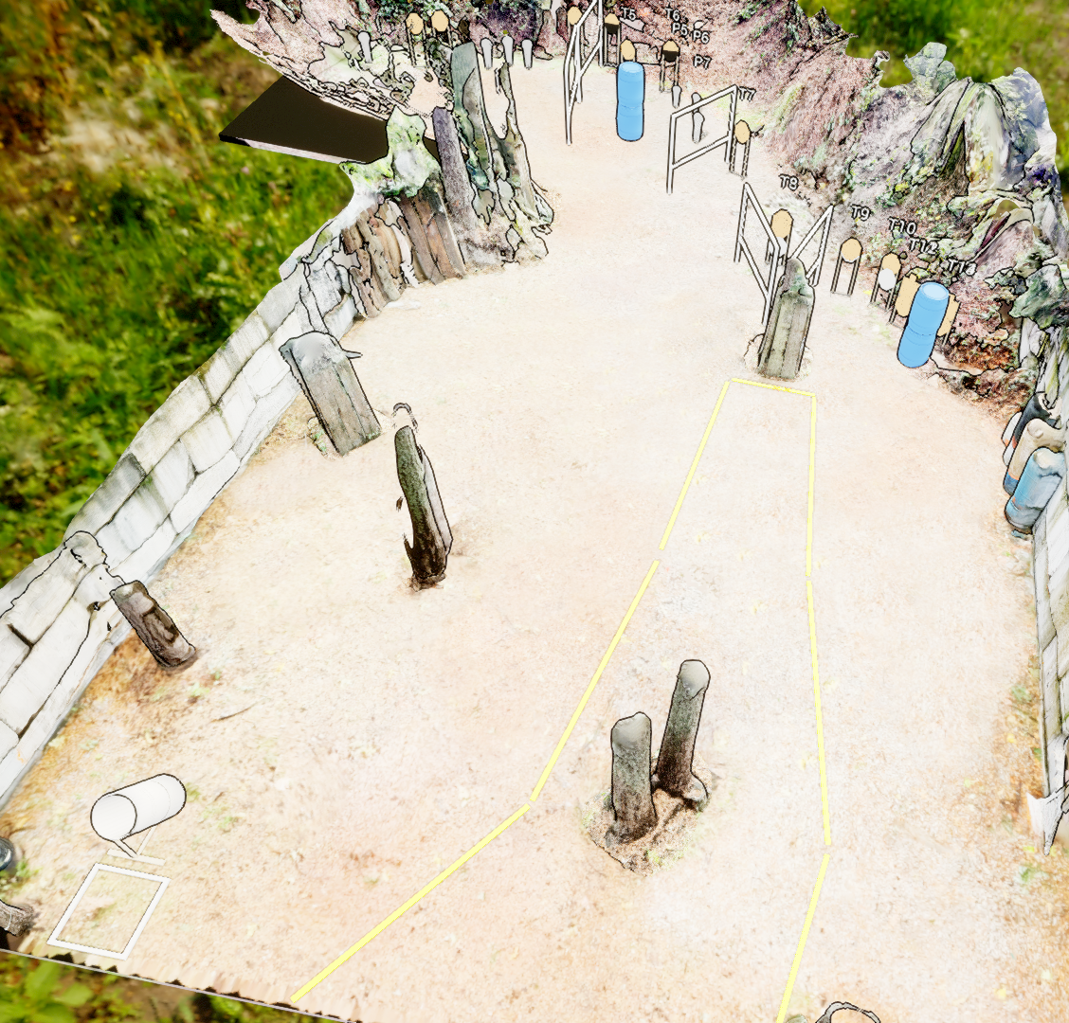
 | Stage 7 nOt A TRACK mEeT Course Designer: Jordan Rogers

